Slide 1
More Rappture Objects
Derrick Kearney
HUBzero® Platform for Scientific Collaboration
Purdue University
Original slides by Michael McLennan
This work licensed under
Creative Commons
See license online:
by-nc-sa/3.0
Notes:
Previous presentation, been using popular elements like integer, number, curve.

Slide 2
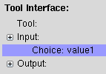
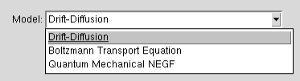
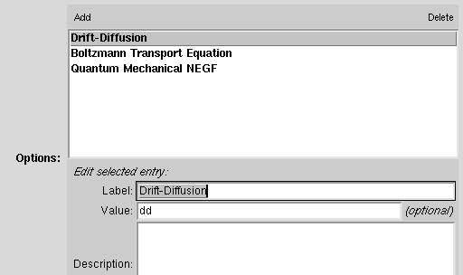
Choices
Add items to the list of choices
Edit the label / value / description
for the selected choice
Notes:
Choice lets users pick from a prepared list of options

Slide 3
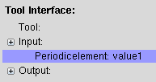
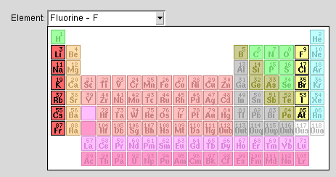
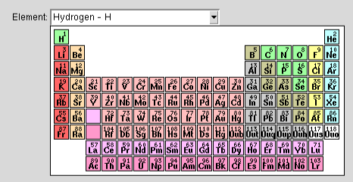
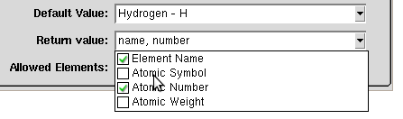
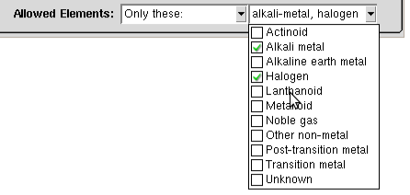
Atoms
Prompt for elements from the periodic table
Controls what gets set as the
<current> value for the selected
element in your program
Enable or disable various sections
of the periodic table
Notes:
From Builder developer controls what info from the table is returned
Developer controls which elements can be chosen, metals, noble gasses ...

Slide 4

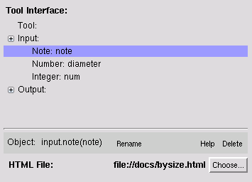
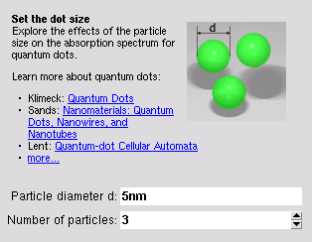
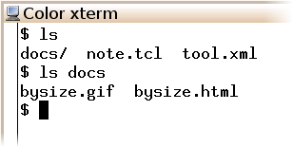
Notes
Use Note objects to embed documentation
Set an ordinary HTML file
Can reference images and other
HTML files in the same directory,
or using absolute http:// paths
Notes:
Notes allow user to embed documentation.
Pictures and html should be in the same directory

Slide 5
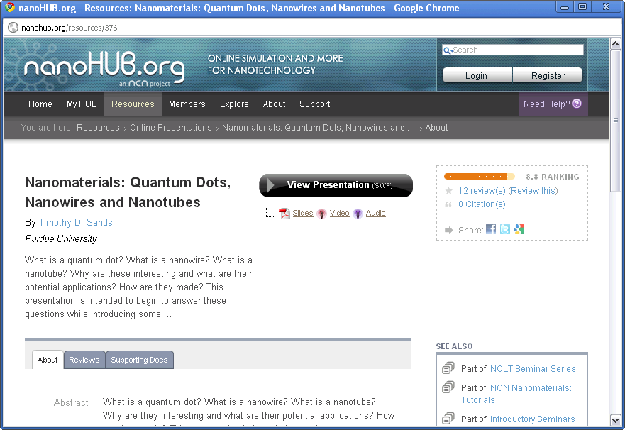
Notes
Note can pop up
external web sites
Example: bysize.html
<html>
<body>
<p>
<img style="float: right; margin: 8px;" src="bysize.gif"/>
<b>Set the dot size</b><br/>
Explore the effects of the particle size on
the absorption spectrum for quantum dots.
</p><p>
Learn more about quantum dots:
<ul style="margin: 0px; padding-left: 16px;">
<li>Klimeck: <a href="http://www.nanohub.org/resources/189">Quantum Dots</a></li>
<li>Sands: <a href="http://www.nanohub.org/resources/376">Nanomaterials: Quantum Dots, Nanowires, and Nanotubes</a></li>
<li>Lent: <a href="http://www.nanohub.org/resources/148">Quantum-dot Cellular Automata</a></li>
<li><a href="http://www.nanohub.org/resources/tags/quantumdots">more...</a></li>
</ul>
</p>
</body>
</html>

Slide 6

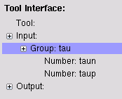

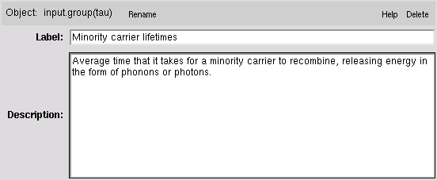

Groups
Use Group objects to group inputs together
Add label/description
to groups
Notes:
Group together inputs that are associated with each other

Slide 7
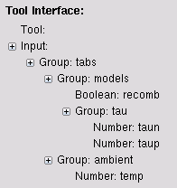
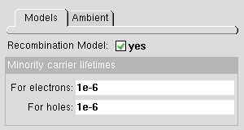
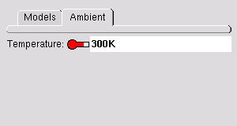
Group of Groups
Group of just groups ⇒ tabs
Group with other elements ⇒ box with group contents

Slide 8

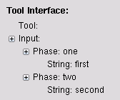
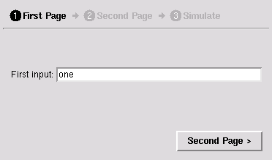
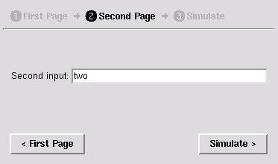
Phase
Use Phase objects to create input panels
Notes:
Phases help walk a user through setting up their simulation
Another way to group inputs

Slide 9
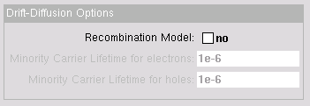
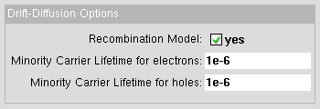
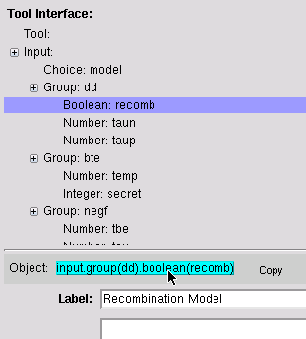
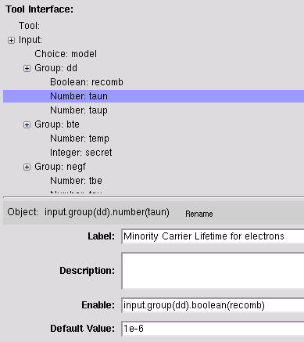
Enable/disable
Use Enable condition to enable/disable inputs
boolean
enables/disables
number entries
2
Paste (CTRL-Y)
into the Enable
condition of each
number
1
Copy the path for the boolean

Slide 10


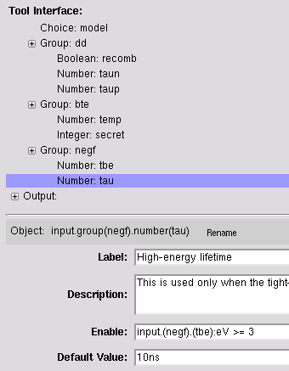
Enable/disable
Enable condition can be an expression
number value
enables/disables
number below it
Get the value of the
tight-binding energy
number
Convert
to eV
input.(negf).(tbe):eV >= 3
Enable High-energy lifetime
whenever tbe >= 3

Slide 11
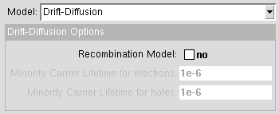



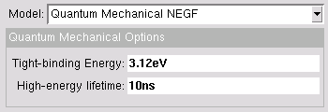

Enable/disable groups
Use Enable condition to enable/disable whole groups
Group
Group
Group

